Slide 1
LEVEL 4/5 GROUP 10
THOMAS MCLAREN
JAMIE OWERS
EDUARD IABLONSCHI
EDWARD PHILLIPS

Slide 2
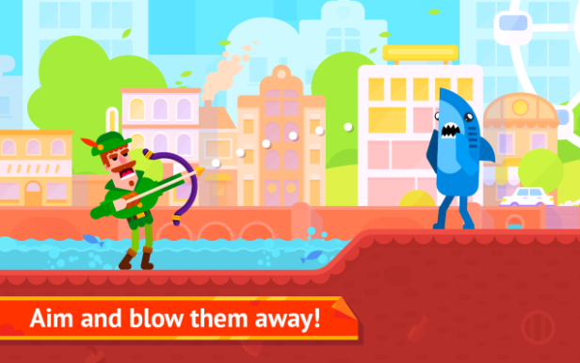
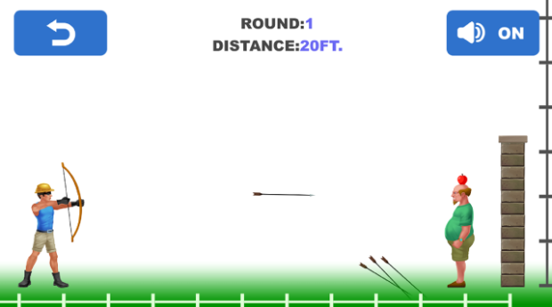
GENRE / STYLE
2D Action game
Mobile only
Competitive 2 player
Notes:
Tom McLaren slide

Slide 3
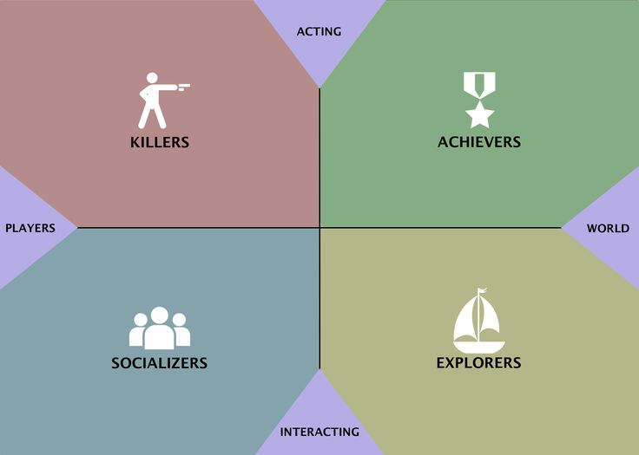
TARGET DEMOGRAPHIC
Socializers
+ Killers
Age:
12+
Gender:
Males & females
Notes:
Jamie Owers Slide

Slide 4
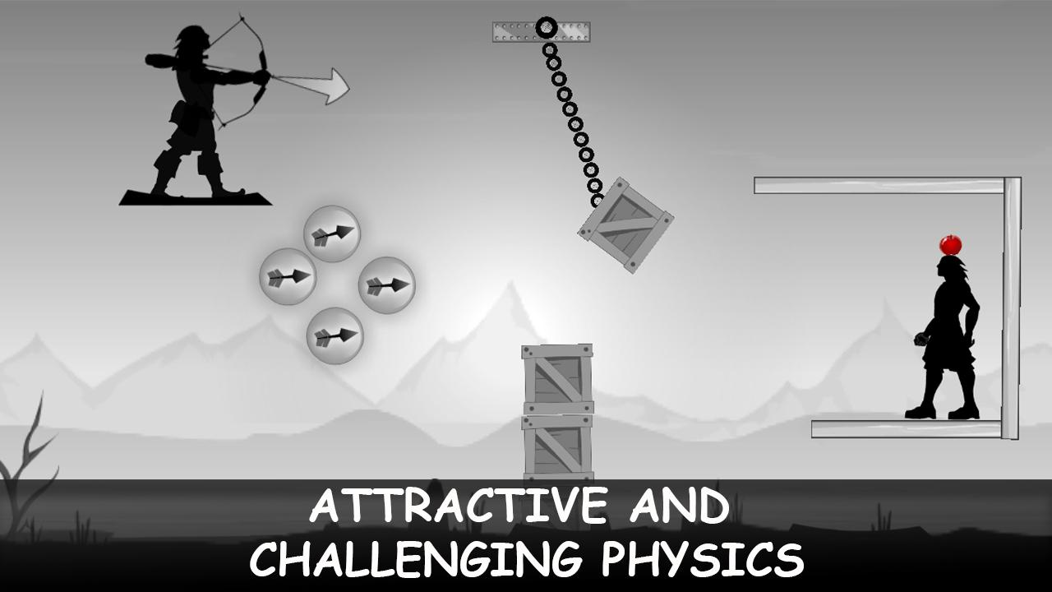
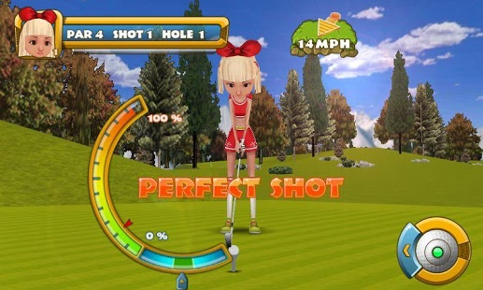
MECHANICS
Symmetric mechanic – Aiming & power selection
Damage – (hit by projectile)
Health bar
Notes:
Eduard Iablonschi Slide

Slide 5
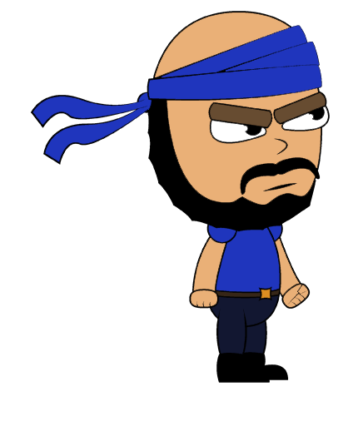
WHAT DOES THE PLAYER DO?
Button press
Competitive - goal
Reflex - selecting trajectory & power
Fiero
Notes:
Tom McLaren Slide

Slide 6
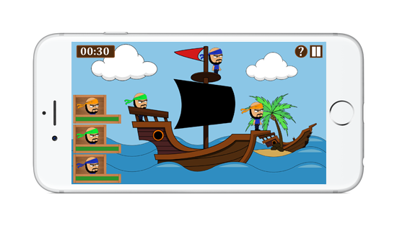
What The Player Sees

Slide 7



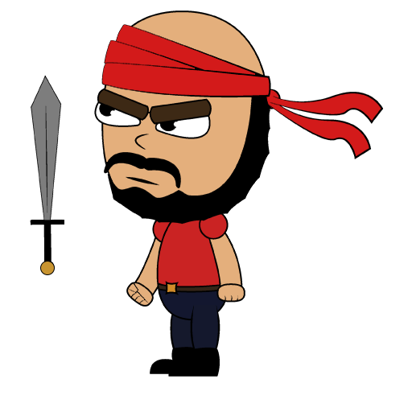


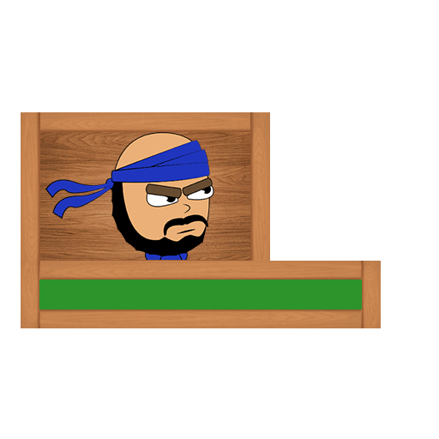
ART STYLE
Notes:
Edward Phillips Slide

Slide 8
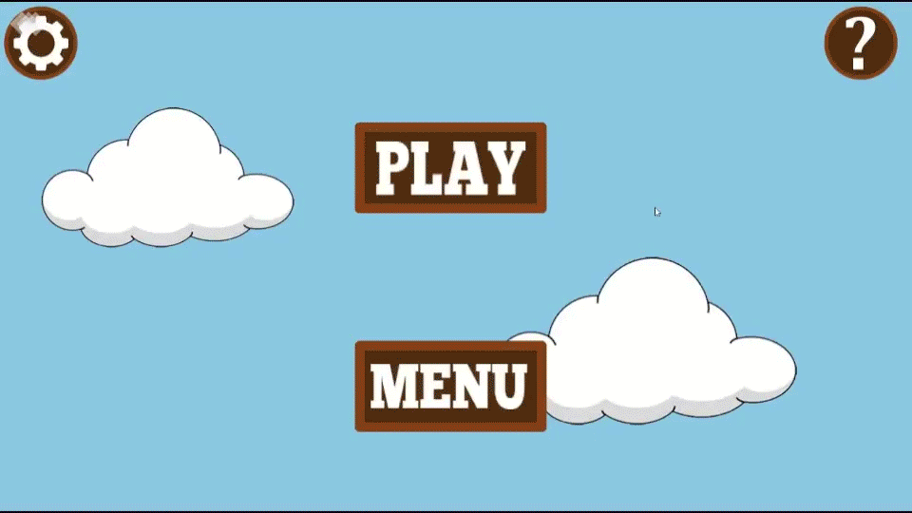
PROTOTYPE

Slide 9
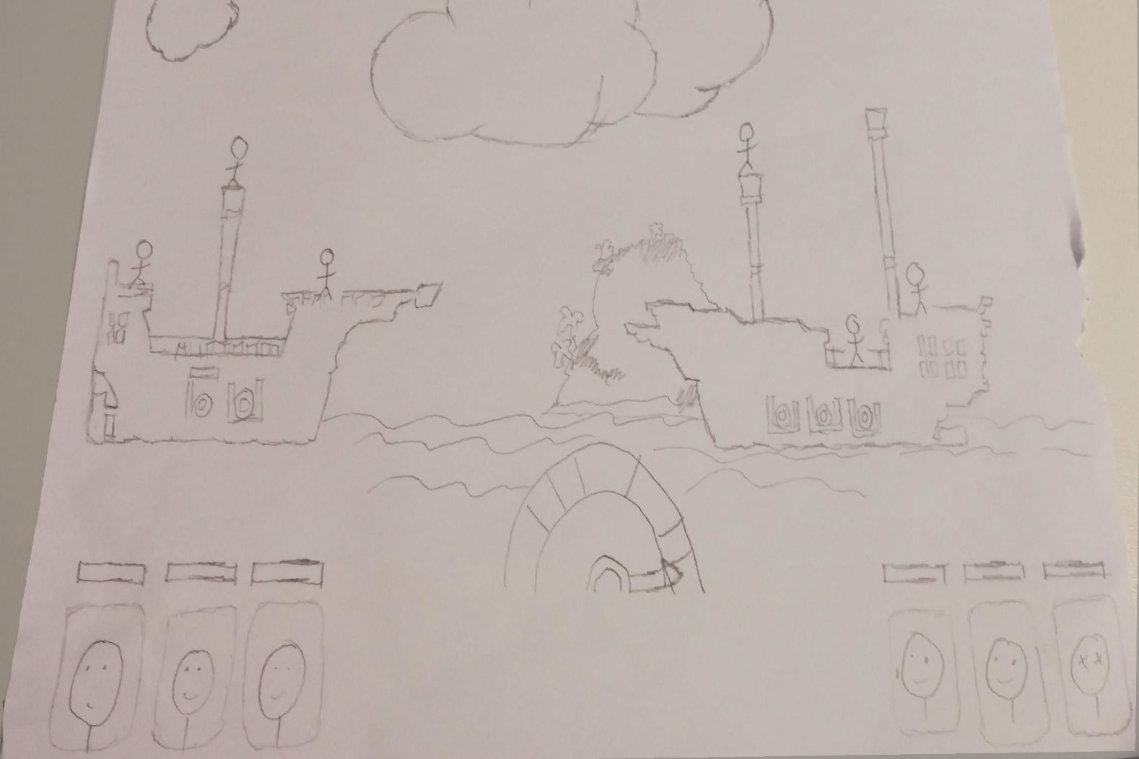
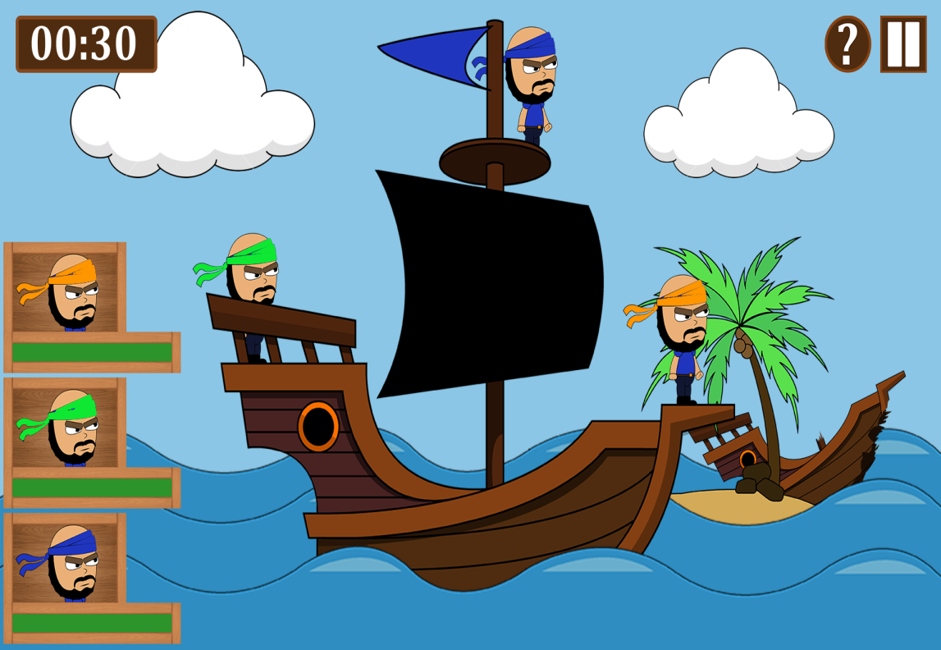
How Has The Game Been Iterated

Slide 10
TARGETS FOR NEXT WEEK
Have the Camera Pan out at the beginning of each turn
Implement a distance gauge for players to see how far away the enemy is
Import sounds gathered and animations created

Slide 11

ANY QUESTIONS?

